Slide 1
Chapter 3: Probability Topics
This presentation is based on material and graphs from Open Stax and is copyrighted by Open Stax and Georgia Highlands College.

Slide 2
Outline
3.1 Terminology
1.2 Data, Sampling, and Variation in Data and Sampling
1.3 Frequency, Frequency Tables, and Levels of Measurement
1.4 Experimental Design and Ethics

Slide 3
Section 3.1 terminology

Slide 4
Introduction
Probability is a measure that is associated with how certain we are of outcomes of a particular experiment or activity.
An experiment is a planned operation carried out under controlled conditions. If the result is not predetermined, then the experiment is said to be a chance experiment.
Flipping one fair coin twice is an example of an experiment.
A result of an experiment is called an outcome.
An event is any combination of outcomes. Uppercase letters like A and B represent events. For example, if the experiment is to flip one fair coin, event A might be getting at most one head. The probability of an event A is written P(A).

Slide 5
Sample space
The sample space of an experiment is the set of all possible outcomes.
Three ways to represent a sample space are:
to list the possible outcomes
to create a tree diagram
to create a Venn diagram
The upper case letter S is used to denote the sample space. For example, if you flip one fair coin,
S={H,T} where H= heads and T= tails are the outcomes.

Slide 6
Probability rules
The probability of any outcome is the long-term relative frequency of that outcome. Probabilities are between zero and one, inclusive (that is, zero and one and all numbers between these values).
P(A) = 0 means the event A can never happen.
P(A) = 1 means the event A always happens.
P(A) = 0.5 means the event A is equally likely to occur or not to occur.
For example, if you flip one fair coin repeatedly (from 20 to 2,000 to 20,000 times) the relative frequency of heads approaches 0.5 (the probability of heads).

Slide 7
Equally Likely
Equally likely means that each outcome of an experiment occurs with equal probability.
For example, if you toss a fair, six-sided die, each face (1, 2, 3, 4, 5, or 6) is as likely to occur as any other face.
If you toss a fair coin, a Head (H) and a Tail (T) are equally likely to occur.
If you randomly guess the answer to a true/false question on an exam, you are equally likely to select a correct answer or an incorrect answer.

Slide 8
Probability
To calculate the probability of an event A when all outcomes in the sample space are equally likely, count the number of outcomes for event A and divide by the total number of outcomes in the sample space.
For example, if you toss a fair dime and a fair nickel, the sample space is {HH, TH, HT, TT} where T = tails and H = heads.
The sample space has four outcomes. A= getting one head. There are two outcomes
that meet this condition {HT,TH}, so P(A) = $\frac{2}{4}$ = 0.5.

Slide 9
Law of Large numbers
This important characteristic of probability experiments is known as the law of large numbers which states that as the number of repetitions of an experiment is increased, the relative frequency obtained in the experiment tends to become closer and closer to the theoretical probability. Even though the outcomes do not happen according to any set pattern or order, overall, the long-term observed relative frequency will approach the theoretical probability. (The word empirical is often used instead of the word observed.)
It is important to realize that in many situations, the outcomes are not equally likely. A coin or die maybe unfair or biased.

Slide 10
“Or” Events
An outcome is in the event A OR B
if the outcome is in A or is in B or is in both A and B.
For example, let A = {1, 2, 3, 4, 5} and B= {4, 5, 6, 7, 8}.
A OR B= {1, 2, 3, 4, 5, 6, 7, 8}.
Notice that 4 and 5 are NOT listed twice.
Hint: remove the duplicates from the final outcome.

Slide 11
“AND” event
An outcome is in the event A AND B if the outcome is in both A and B at the same time.
For example, let A and B be{1,2, 3, 4, 5} and {4, 5, 6, 7, 8}, respectively.
Then A AND B= {4, 5}.
Hint: Both events only have 4 and 5 in common.

Slide 12
Complement (‘)
The complement of event A is denoted A′ (read "A prime“ ) . A ′ consists of all outcomes that are NOT in A.
Notice that P(A) + P(A′) = 1.
For example, let S = {1, 2, 3, 4, 5, 6} and let A = {1, 2, 3, 4}.
Then, A′ = {5, 6}.

Slide 13
conditional probability
The conditional probability of A given B is written P(A|B).
P(A|B) is the probability that event A will occur given that the event B has already occurred.
A conditional reduces the sample space. We calculate the probability of A from the reduced sample space B. The formula to
calculate P(A|B) is P(A|B) = $\frac{P(A and B)}{P(B)}$ where P(B) is not zero.

Slide 14
Examples
The sample space S is the whole numbers starting at one and less than 20.
a. S= {1,2,3,4,5,6,7,8,9,10,11,12,13,14,15,16,17,18,19}
Let event A= the even numbers and event B= numbers greater than 13.
b. A= _____________________, B= _____________________
c. P(A) = _____________,P(B) = ________________
d. A AND B= ____________________,A OR B= ________________
e. P(A AND B) = _________,P(A OR B) = _____________
f. A′= _____________,P(A′) = _____________
g. P(A) +P(A′) = ____________
h. P(A|B) = ___________,P(B|A) = _____________; are the probabilities equal?

Slide 15
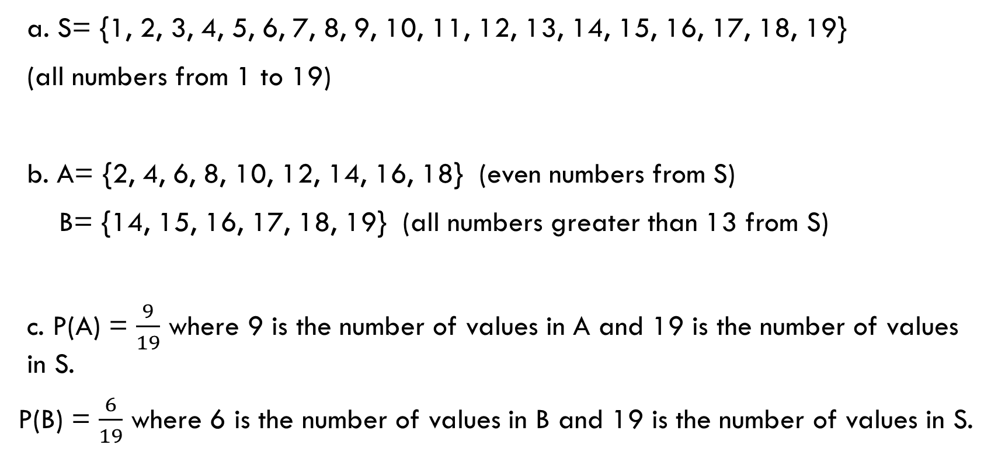
Example answers explained
a. S= {1, 2, 3, 4, 5, 6, 7, 8, 9, 10, 11, 12, 13, 14, 15, 16, 17, 18, 19}
(all numbers from 1 to 19)
b. A= {2, 4, 6, 8, 10, 12, 14, 16, 18} (even numbers from S)
B= {14, 15, 16, 17, 18, 19} (all numbers greater than 13 from S)
c. P(A) = $\frac{9}{19}$ where 9 is the number of values in A and 19 is the number of values in S.
P(B) = $\frac{6}{19}$ where 6 is the number of values in B and 19 is the number of values in S.

Slide 16
Example answers explained
d. A AND B= {14,16,18}, The numbers found in both A and B
A OR B= {2, 4, 6, 8, 10, 12, 14, 15, 16, 17, 18, 19}
The numbers found in either A or B
e. P(A AND B) = $\frac{3}{19}$
P (A OR B) = $\frac{12}{19}$

Slide 17

Example answers explained
f. A′= 1, 3, 5, 7, 9, 11, 13, 15, 17, 19;
P(A′) = $\frac{10}{19}$
g. P(A) +P(A′) = $\frac{10}{19}$ + $\frac{9}{19}$ = $\frac{19}{19}$ or 1
h. P(A|B) = $\frac{P(A and B)}{P(B)}$ = $\frac{\frac{3}{19}}{\frac{6}{19}}$ = $\frac{3}{19}$ * $\frac{19}{6}$ = $\frac{3}{6}$

Slide 18
Example answers explained
h. P(B|A) = $\frac{P(A and B)}{P(A)}$ = $\frac{\frac{3}{19}}{\frac{9}{19}}$ = $\frac{3}{19}$ * $\frac{19}{9}$ = $\frac{3}{9}$
The Probabilities are not equal for P(B|A) and P(A|B)

Slide 19
Another Example
 | Right-handed | Left-handed
Male | 43 | 9
Female | 44 | 4
Let’s denote the events M=the subject is male, F= the subject is female, R=the subject is right-handed, L=the subject is left-handed

Slide 20
Another example
a. P(M)
b. P(F)
c. P(R)
d. P(L)
e. P(M AND R)
f. P(F AND L)
g. P(M OR F)
h. P(M OR R)
i. P(F OR L)
j. P(M')
k. P(R|M)
l. P(F|L)
m. P(L|F)

Slide 21
Answers
a. P(M) = 0.52
b. P(F) = 0.48
c. P(R) = 0.87
d. P(L) = 0.13
e. P(M AND R) = 0.43
f. P(F AND L) = 0.04
g. P(M OR F) = 1
h. P(M OR R) = 0.96
i. P(F OR L) = 0.57
j. P(M') = 0.48
k. P(R|M) = 0.8269 (rounded to four decimal places)
l. P(F|L) = 0.3077 (rounded to four decimal places)
m. P(L|F) = 0.0833

Slide 22
3.2 Independent and Mutually Exclusive Events

Slide 23
3.2 Independent and Mutually Exclusive Events
Independent and mutually exclusive do not mean the same thing.
Independent Events
Two events are independent if the following are true:
• P(A|B) =P(A)
• P(B|A) =P(B)
• P(A AND B) =P(A)P(B)

Slide 24
3.2 Independent and Mutually Exclusive Events
Two events A and B are independent if the knowledge that one occurred does not affect the chance the other occurs.
For example, the outcomes of two roles of a fair die are independent events.
The outcome of the first roll does not change the probability for the outcome of the second roll.
To show two events are independent, you must show only one of the above conditions.
If two events are NOT independent, then we say that they are dependent.

Slide 25
replacement
Sampling may be done with replacement or without replacement.
• With replacement: If each member of a population is replaced after it is picked, then that member has the possibility of being chosen more than once. When sampling is done with replacement, then events are considered to be independent, meaning the result of the first pick will not change the probabilities for the second pick.
• Without replacement: When sampling is done without replacement, each member of a population may be chosen only once. In this case, the probabilities for the second pick are affected by the result of the first pick. The events are considered to be dependent or not independent.
If it is not known whether A and B are independent or dependent, assume they are dependent until you can show otherwise.

Slide 26
Mutually exclusive events
A and B are mutually exclusive events if they cannot occur at the same time. This means that A and B do not share any outcomes and P(A AND B) = 0.
For example, S = {1, 2, 3, 4, 5, 6, 7, 8, 9, 10}.
Let A = {1, 2, 3, 4, 5}, B = {4, 5, 6, 7, 8}, C ={7,9}.
A AND B={4,5}. P(A AND B)= $\frac{2}{10}$ and is not equal to zero. Therefore, A and B are not mutually exclusive.
A and C do not have any numbers in common so P(A AND C) = 0. Therefore, A and C are mutually exclusive.

Slide 27
Example
Let event G = taking a math class. P(G) = 0.6
Let event H = taking a science class. P(H) = 0.5
Then, G AND H = taking a math class and a science class. P(G AND H) = 0.3
Are G and H independent?
If G and H are independent, then you must show ONE of the following:
• P(G|H) =P(G)
• P(H|G) =P(H)
• P(G AND H) =P(G)P(H)

Slide 28
Example answers
Are G and H independent?
If G and H are independent, then you must show ONE of the following:
• P(G|H) =P(G) = $\frac{\text{P}\text{(}\text{G} \text{AND} \text{H}\text{)}}{\text{P}\text{(}\text{H}\text{)}}$=$\frac{\text{0.3}}{\text{0.}\text{5}}$ = 0.6 =P(G)
• P(H|G) =P(H) = $\frac{\text{P}\text{(}\text{H} \text{AND} \text{G}\text{)}}{\text{P}\text{(}\text{G}\text{)}}$=$\frac{\text{0.3}}{\text{0.}\text{6}}$ = 0.5 =P(H)
• P(G AND H) =P(G)P(H) is the same as:
P(G)P(H) = (0.6)(0.5) = 0.3 =P(G AND H)
They are independent since one or more is true.

Slide 29
3.3 Two Basic Rules of Probability

Slide 30
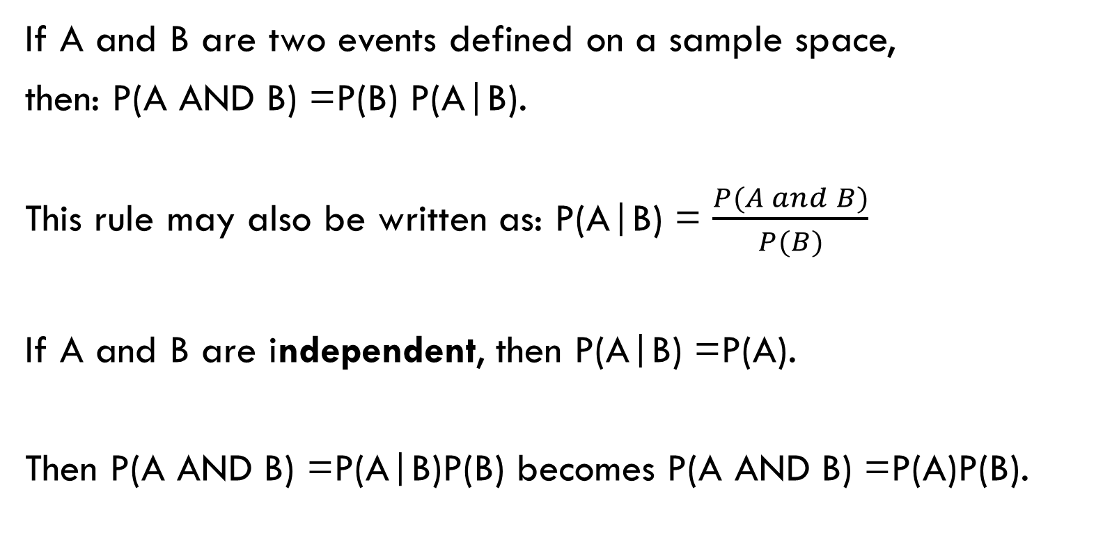
The Multiplication Rule “And”
If A and B are two events defined on a sample space,
then: P(A AND B) =P(B) P(A|B).
This rule may also be written as: P(A|B) = $\frac{P(A and B)}{P(B)}$
If A and B are independent, then P(A|B) =P(A).
Then P(A AND B) =P(A|B)P(B) becomes P(A AND B) =P(A)P(B).

Slide 31
The Addition Rule “or”
If A and Bare defined on a sample space,
then: P(A OR B) =P(A) +P(B) - P(A AND B).
If A and B are mutually exclusive, then P(A AND B) = 0.
Then P(A OR B)=P(A)+P(B)-P(A AND B)
Becomes P(A OR B)=P(A) +P(B).

Slide 32
Example 1
Felicity attends Modesto JC in Modesto, CA. The probability that Felicity enrolls in a math class is 0.2 and the probability that she enrolls in a speech class is 0.65. The probability that she enrolls in a math class GIVEN that she enrolls in speech class is 0.25.
Let: M= math class, S= speech class, M|S= math given speech
a. What is the probability that Felicity enrolls in math and speech?
Find P(M AND S) =P(M|S) P(S).
b. What is the probability that Felicity enrolls in math or speech classes? Find P(M OR S) =P(M) +P(S) -P(M AND S).
c. Are M and S independent? Is P(M|S) =P(M)?
d. Are M and S mutually exclusive? Is P(M AND S) = 0?

Slide 33
Example 1
Let: M= math class (0.2) , S= speech class (0.65) , M|S= math given speech (0.25)
a. What is the probability that Felicity enrolls in math and speech?
Find P(M AND S) =P(M|S) P(S).
P(M AND S) = 0.25 * 0.65 = 0.1625
b. What is the probability that Felicity enrolls in math or speech classes?
Find P(M OR S) =P(M) +P(S) -P(M AND S).
P(M OR S) = 0.2 + 0.65 – 0.1625 = 0.6875

Slide 34
Example 1
Let: M= math class (0.2) , S= speech class (0.65) , M|S= math given speech (0.25)
c. Are M and S independent? Is P(M|S) =P(M)?
0.25 ≠ 0.2 so No
d. Are M and S mutually exclusive? Is P(M AND S) = 0?
P(M AND S) = 0.25 * 0.65 = 0.1625 which doesn’t equal 0 so No

