Slide 1
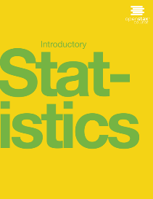
Introductory statistics
Chapter 5 Continuous Random Variables

Slide 2
Chapter 5: Continuous Random Variables
5.1 Continuous Probability Functions
5.2 The Uniform Distribution
5.3 The Exponential Distribution
5.4 Continuous Distribution

Slide 3
Chapter Objectives
By the end of this chapter, the student should be able to:
Recognize and understand continuous probability density functions in general.
Recognize the uniform probability distribution and apply it appropriately.
Recognize the exponential probability distribution and apply it appropriately.

Slide 4
Properties of Continuous Probability Distributions
The graph of a continuous probability distribution is a curve. Probability is represented by area under the curve.
The curve is called the probability density function (abbreviated as pdf). We use the symbol f(x) to represent the curve. f(x) is the function that corresponds to the graph; we use the density function f(x) to draw the graph of the probability
distribution.

Slide 5
cumulative distribution function
Area under the curve is given by a different function called the cumulative distribution function (abbreviated as cdf). The cumulative distribution function is used to evaluate probability as area.
The outcomes are measured, not counted.
The entire area under the curve and above the x-axis is equal to one.
Probability is found for intervals of x values rather than for individual x values.
P(c < x < d) is the probability that the random variable X is in the interval between the values c and d. P(c < x < d) is the area under the curve, above the x-axis, to the right of c and the left of d.
P(x = c) = 0 The probability that x takes on any single individual value is zero. The area below the curve, above the x-axis, and between x = c and x = c has no width, and therefore no area (area = 0). Since the probability is equal to the area, the probability is also zero.
P(c < x < d) is the same as P(c ≤ x ≤ d) because probability is equal to area.

Slide 6
the uniform, exponential, and normal distributions

Slide 7
5.1 Continuous Probability Functions
We begin by defining a continuous probability density function. We use the function notation f(x). We define the function f(x) so that the area between it and the x-axis is equal to a probability. Since the maximum probability is one, the maximum area is also one. For continuous probability distributions, PROBABILITY = AREA.

Slide 8
5.2 The Uniform Distribution
The uniform distribution is a continuous probability distribution and is concerned with events that are equally likely to occur. When working out problems that have a uniform distribution, be careful to note if the data is inclusive or exclusive.
The notation for the uniform distribution is
X ~ U(a, b)
where a = the lowest value of x and b = the highest value of x.
The probability density function is
Formulas for the theoretical mean and standard deviation are

Slide 9
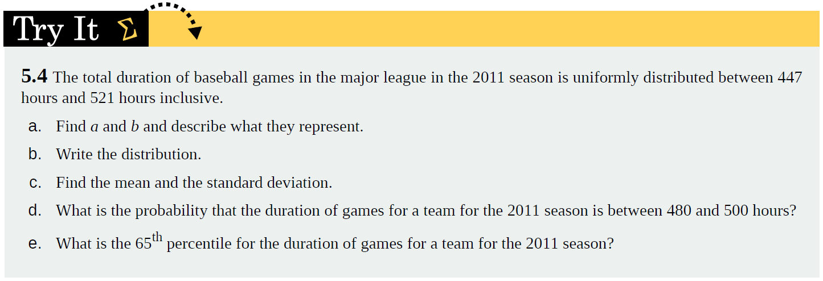
Example

Slide 10
Example

Slide 11
5.3 The Exponential Distribution
The exponential distribution is often concerned with the amount of time until some specific event occurs. For example, the amount of time (beginning now) until an earthquake occurs has an exponential distribution. Other examples include the length, in minutes, of long distance business telephone calls, and the amount of time, in months, a car battery lasts. It can be shown, too, that the value of the change that you have in your pocket or purse approximately follows an exponential distribution.
Values for an exponential random variable occur in the following way. There are fewer large values and more small values. For example, the amount of money customers spend in one trip to the supermarket follows an exponential distribution. There are more people who spend small amounts of money and fewer people who spend large amounts of money.
The exponential distribution is widely used in the field of reliability. Reliability deals with the amount of time a product lasts.

Slide 12
Example 5.7
Let X = amount of time (in minutes) a postal clerk spends with his or her customer. The time is known to have an exponential distribution with the average amount of time equal to four minutes.
X is a continuous random variable since time is measured. It is given that μ = 4 minutes. To do any calculations, you must know m, the decay parameter.
m = 1/μ . Therefore, m =1/4= 0.25.
The standard deviation, σ, is the same as the mean. μ = σ
The distribution notation is X ~ Exp(m). Therefore, X ~ Exp(0.25).
The probability density function is f(x) = me^{-mx}.

Slide 13
Example Continued
a. Using the information from previous exercise, find the probability that a clerk spends four to five minutes with a randomly selected customer.
Solution
a. Find P(4 < x < 5).
The cumulative distribution function (CDF) gives the area to the left.
P(x < x) = 1 – e^{–mx}
P(x < 5) = 1 – e^{(–0.25)(5)} = 0.7135 and
P(x < 4) = 1 – e^{(–0.25)(4)} = 0.6321
The probability that a postal clerk spends four to five minutes with a randomly selected customer is P(4 < x < 5) = P(x < 5) – P(x < 4) = 0.7135 − 0.6321 = 0.0814.

Slide 14
Example Continued
b. Half of all customers are finished within how long? (Find the 50th percentile)
Solution
b. Find the 50th percentile.
P(x < k) = 0.50 and P(x < k) = 1 –e^{–0.25k}
Therefore, 0.50 = 1 − e^{−0.25k} and
e^{−0.25k} = 1 − 0.50 = 0.5
Take natural logs: ln(e^{–0.25k}) = ln(0.50). So, –0.25k = ln(0.50)
Solve for k:
k = ln(0.50)/-0.25 = 2.8 minutes

Slide 15
Example

