Slide 1
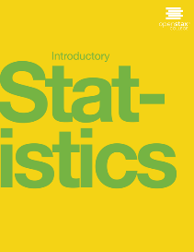
Introductory statistics
Chapter 7 The Central Limit Theorem

Slide 2
Chapter 7: The Central Limit Theorem
7.1 The Central Limit Theorem for Sample Means (Averages)
7.2 The Central Limit Theorem for Sums
7.3 Using the Central Limit Theorem

Slide 3
Chapter Objectives
By the end of this chapter, the student should be able to:
Recognize central limit theorem problems.
Classify continuous word problems by their distributions.
Apply and interpret the central limit theorem for means.
Apply and interpret the central limit theorem for sums.

Slide 4
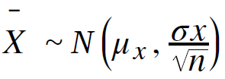
7.1 The Central Limit Theorem for Sample Means (Averages)
Suppose X is a random variable with a distribution that may be known or unknown (it can be any distribution). Using a subscript that matches the random variable, suppose:
a. μ_{X} = the mean of X
b. σ_{X} = the standard deviation of X
If you draw random samples of size n, then as n increases, the random variable X which consists of sample means, tends to be normally distributed and

Slide 5
The Central Limit Theorem
The central limit theorem for sample means says that if you keep drawing larger and larger samples (such as rolling one, two, five, and finally, ten dice) and calculating their means, the sample means form their own normal distribution (the sampling distribution). The normal distribution has the same mean as the original distribution and a variance that equals the original variance divided by, the sample size. The variable n is the number of values that are averaged together, not the number of times the experiment is done.
To put it more formally, if you draw random samples of size n, the distribution of the random variable X, which consists of sample means, is called the sampling distribution of the mean. The sampling distribution of the mean approaches a normal distribution as n, the sample size, increases.

Slide 6
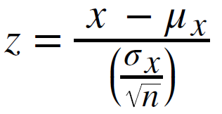
Standard Error of the Mean
The random variable X has a different z-score associated with it from that of the random variable X. The mean x is the value of X in one sample.
μ_{X} is the average of both X and X.
standard deviation of X and is called the
standard error of the mean.

Slide 7
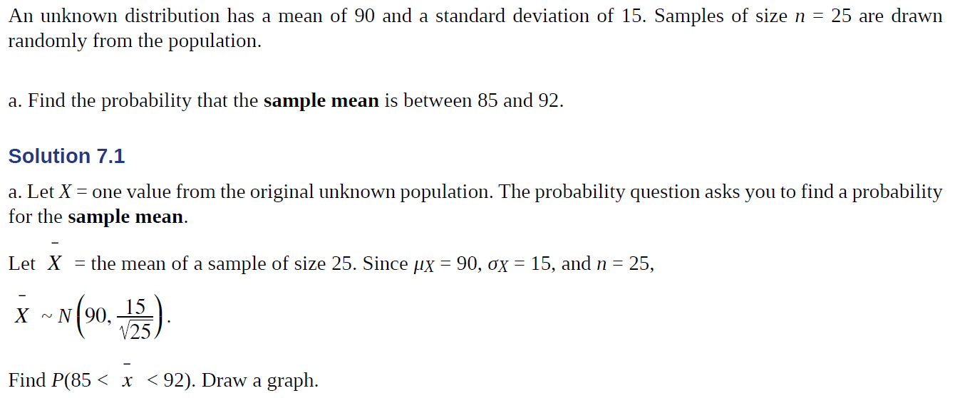
Example 7.1

Slide 8
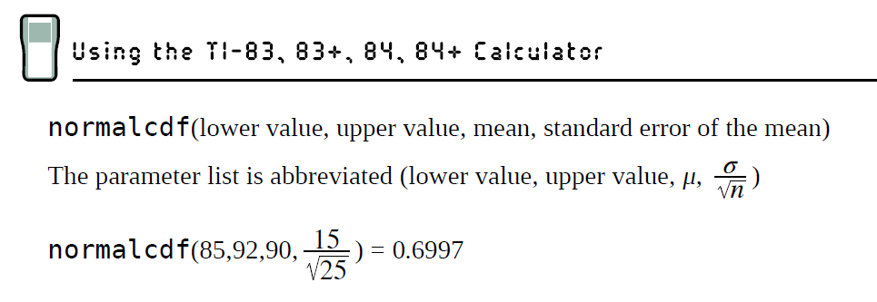
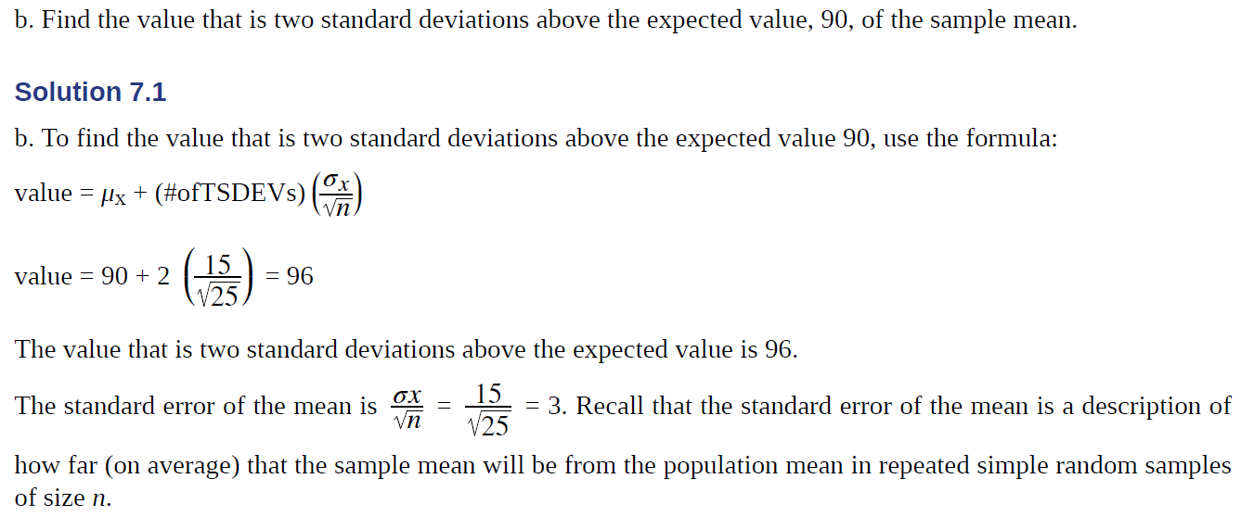
Example 7.1 Solution

Slide 9
Example 7.3

Slide 10
7.2 The Central Limit Theorem for Sums
Suppose X is a random variable with a distribution that may be known or unknown (it can be any distribution) and suppose:
a. μ_{X} = the mean of Χ
b. σ_{Χ} = the standard deviation of X
If you draw random samples of size n, then as n increases, the random variable ΣX consisting of sums tends to be normally distributed and

Slide 11
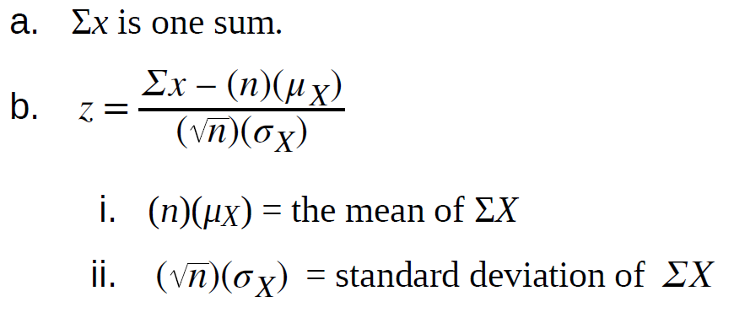
The Central Limit Theorem for Sums
The central limit theorem for sums says that if you keep drawing larger and larger samples and taking their sums, the sums form their own normal distribution (the sampling distribution), which approaches a normal distribution as the sample size increases.
The normal distribution has a mean equal to the original mean multiplied by the sample size and a standard deviation equal to the original standard deviation multiplied by the square root of the sample size.
The random variable ΣX has the following z-score associated with it:

Slide 12
Example 7.5
An unknown distribution has a mean of 90 and a standard deviation of 15. A sample of size 80 is drawn randomly from the population.
a. Find the probability that the sum of the 80 values (or the total of the 80 values) is more than 7,500.
b. Find the sum that is 1.5 standard deviations above the mean of the sums.

Slide 13
7.3 Using the Central Limit Theorem
Examples of the Central Limit Theorem
Law of Large Numbers
The law of large numbers says that if you take samples of larger and larger size from any population, then the mean x of the sample tends to get closer and closer to μ. From the central limit theorem, we know that as n gets larger and larger, the sample means follow a normal distribution. The larger n gets, the smaller the standard deviation gets. This means that the sample mean x must be close to the population mean μ. We can say that μ is the value that the sample means approach as n gets larger. The central limit theorem illustrates the law of large numbers.

Slide 14
Central Limit Theorem for the Mean and Sum Examples
Example 7.8
A study involving stress is conducted among the students on a college campus. The stress scores follow a uniform distribution with the lowest stress score equal to one and the highest equal to five. Using a sample of 75 students, find:
a. The probability that the mean stress score for the 75 students is less than two.
b. The 90th percentile for the mean stress score for the 75 students.
c. The probability that the total of the 75 stress scores is less than 200.
d. The 90th percentile for the total stress score for the 75 students.

Slide 15
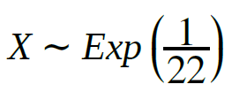
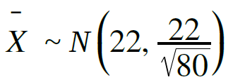
Example 7.9
Suppose that a market research analyst for a cell phone company conducts a study of their customers who exceed the time allowance included on their basic cell phone contract; the analyst finds that for those people who exceed the time included in their basic contract, the excess time used follows an exponential distribution with a mean of 22 minutes.
Consider a random sample of 80 customers who exceed the time allowance included in their basic cell phone contract.
Let X = the excess time used by one INDIVIDUAL cell phone customer who exceeds his contracted time allowance.
. From previous chapters, we know that μ = 22 and σ = 22.
Let X = the mean excess time used by a sample of n = 80 customers who exceed their contracted time allowance.
by the central limit theorem for sample means

Slide 16
Example 7.9 Continued
Using the CLT to find probability
a. Find the probability that the mean excess time used by the 80 customers in the sample is longer than 20 minutes. This is asking us to find P( x > 20). Draw the graph.
b. Suppose that one customer who exceeds the time limit for his cell phone contract is randomly selected. Find the probability that this individual customer's excess time is longer than 20 minutes. This is asking us to find P(x > 20).
c. Explain why the probabilities in parts a and b are different.

