Slide 1
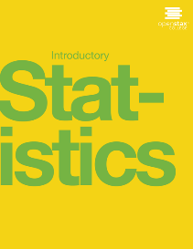

Introductory statistics
Chapter 8 Confidence Intervals

Slide 2

Chapter 8: Confidence Intervals
8.1 A Single Population Mean using the Normal Distribution
8.2 A Single Population Mean using the Student t Distribution
8.3 A Population Proportion

Slide 3
Chapter Objectives
By the end of this chapter, the student should be able to:
  Calculate and interpret confidence intervals for estimating a population mean and a population proportion.
  Interpret the Student's t probability distribution as the sample size changes.
  Discriminate between problems applying the normal and the Student's t distributions.
  Calculate the sample size required to estimate a population mean and a population proportion given a desired confidence level and margin of error.

Slide 4
Introduction
We use sample data to make generalizations about an unknown population. This part of statistics is called inferential statistics. The sample data help us to make an estimate of a population parameter.
  Suppose you were trying to determine the mean rent of a two-bedroom apartment in your town. You might look in the classified section of the newspaper, write down several rents listed, and average them together. You would have obtained a point estimate of the true mean.
  We realize that the point estimate is most likely not the exact value of the population parameter, but close to it. After calculating point estimates, we construct interval estimates, called confidence intervals.

Slide 5
Point Estimate
In this chapter, you will learn to construct and interpret confidence intervals. You will also learn a new distribution, the Student's-t, and how it is used with these intervals. Throughout the chapter, it is important to keep in mind that the confidence interval is a random variable. It is the population parameter that is fixed.
  If you worked in the marketing department of an entertainment company, you might be interested in the mean number of songs a consumer downloads a month from iTunes. If so, you could conduct a survey and calculate the sample mean, x, and the sample standard deviation, s. You would use x to estimate the population mean and s to estimate the population standard deviation. The sample mean, x, is the point estimate for the population mean, μ. The sample standard deviation, s, is the point estimate for the population standard deviation, σ.
  Each of x and s is called a statistic.

Slide 6
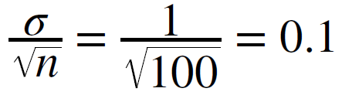
Confidence Interval Example
A confidence interval is another type of estimate but, instead of being just one number, it is an interval of numbers. The interval of numbers is a range of values calculated from a given set of sample data. The confidence interval is likely to include an unknown population parameter.
  Suppose, for the iTunes example, we do not know the population mean μ, but we do know that the population standard deviation is σ = 1 and our sample size is 100. Then, by the central limit theorem, the standard deviation for the sample mean is
  The empirical rule, which applies to bell-shaped distributions, says that in approximately 95% of the samples, the sample mean, x, will be within two standard deviations of the population mean μ. For our iTunes example, two standard deviations is (2)(0.1) = 0.2. The sample mean x is likely to be within 0.2 units of μ.

Slide 7
Itunes Example continued
  Because x is within 0.2 units of μ, which is unknown, then μ is likely to be within 0.2 units of x in 95% of the samples.
  The population mean μ is contained in an interval whose lower number is calculated by taking the sample mean and subtracting two standard deviations (2)(0.1) and whose upper number is calculated by taking the sample mean and adding two standard deviations. In other words, μ is between x − 0.2 and x + 0.2 in 95% of all the samples.
  For the iTunes example, suppose that a sample produced a sample mean x = 2 . Then the unknown population mean μ is between
We say that we are 95% confident that the unknown population mean number of songs downloaded from iTunes per month is between 1.8 and 2.2. The 95% confidence interval is (1.8, 2.2).

Slide 8
Interpretation of the Confidence interval
  The 95% confidence interval implies two possibilities. Either the interval (1.8, 2.2) contains the true mean μ or our sample produced an x that is not within 0.2 units of the true mean μ. The second possibility happens for only 5% of all the samples (95–100%).
  Remember that a confidence interval is created for an unknown population parameter like the population mean, μ.
Confidence intervals for some parameters have the form:
(point estimate – margin of error, point estimate + margin of error)
  The margin of error depends on the confidence level or percentage of confidence and the standard error of the mean.
  When you read newspapers and journals, some reports will use the phrase "margin of error." Other reports will not use that phrase, but include a confidence interval as the point estimate plus or minus the margin of error. These are two ways of expressing the same concept.

Slide 9

8.1 A Single Population Mean using the Normal Distribution
Calculating the Confidence Interval
To construct a confidence interval for a single unknown population mean μ, where the population standard deviation is known, we need x as an estimate for μ and we need the margin of error. Here, the margin of error (EBM) is called the error bound for a population mean (abbreviated EBM). The sample mean x is the point estimate of the unknown population mean μ.
The confidence interval estimate will have the form:
(point estimate - error bound, point estimate + error bound) or, in symbols,

Slide 10
Margin of Error and Confidence Level
The margin of error (EBM) depends on the confidence level (abbreviated CL). The confidence level is often considered the probability that the calculated confidence interval estimate will contain the true population parameter. However, it is more accurate to state that the confidence level is the percent of confidence intervals that contain the true population parameter when repeated samples are taken. Most often, it is the choice of the person constructing the confidence interval to choose a confidence level of 90% or higher because that person wants to be reasonably certain of his or her conclusions.
There is another probability called alpha (α). α is related to the confidence level, CL. α is the probability that the interval does not contain the unknown population parameter. Mathematically, α + CL = 1.

Slide 11
Calculating the Confidence Interval
To construct a confidence interval estimate for an unknown population mean, we need data from a random sample. The steps to construct and interpret the confidence interval are:
  Calculate the sample mean x from the sample data. Remember, in this section we already know the population standard deviation σ.
  Find the z-score that corresponds to the confidence level.
  Calculate the error bound EBM.
  Construct the confidence interval.
  Write a sentence that interprets the estimate in the context of the situation in the problem. (Explain what the confidence interval means, in the words of the problem.)

Slide 12
Finding the z-score for the Stated Confidence Level
When we know the population standard deviation σ, we use a standard normal distribution to calculate the error bound EBM and construct the confidence interval. We need to find the value of z that puts an area equal to the confidence level (in decimal form) in the middle of the standard normal distribution Z ~ N(0, 1).
  The confidence level, CL, is the area in the middle of the standard normal distribution. CL = 1 – α, so α is the area that is split equally between the two tails. Each of the tails contains an area equal to α/2
  The z-score that has an area to the right of α/2 is denoted by z_{α/2}.
  For example, when CL = 0.95, α = 0.05 and α/2= 0.025; we write z_{α/2}= z_{0.025}.
  The area to the right of z_{0.025} is 0.025 and the area to the left of z_{0.025} is 1 – 0.025 = 0.975.
  z_{α/2}= z_{0.025} = 1.96, using a calculator, computer or a standard normal probability table.
    Calculator: invNorm(0.975, 0, 1) = 1.96

Slide 13
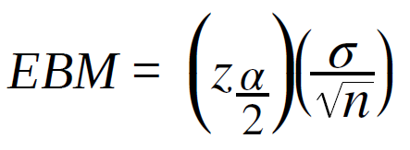
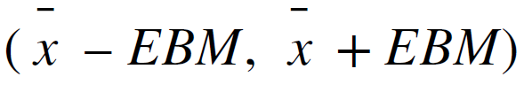
Calculating the Error Bound (EBM)
The error bound formula for an unknown population mean μ when the population standard deviation σ is known is
Constructing the Confidence Interval
The confidence interval estimate has the format

Slide 14
Example 8.2
Suppose scores on exams in statistics are normally distributed with an unknown population mean and a population standard deviation of three points. A random sample of 36 scores is taken and gives a sample mean (sample mean score) of 68. Find a confidence interval estimate for the population mean exam score (the mean score on all exams).
Find a 90% confidence interval for the true (population) mean of statistics exam scores.

Slide 15
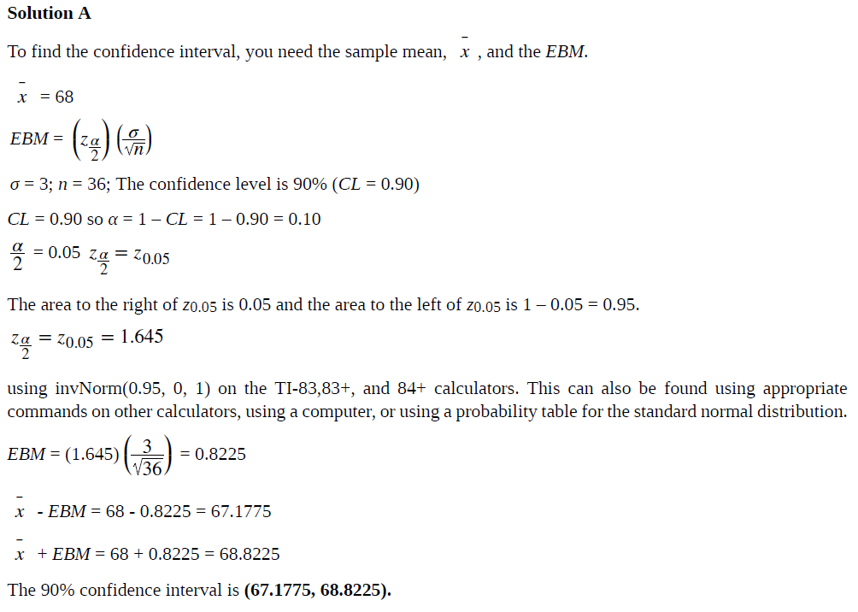

Slide 16
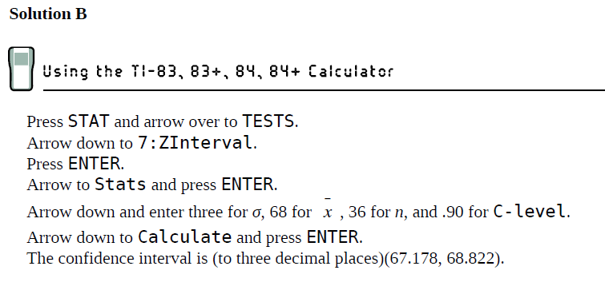
Interpretation
We estimate with 90% confidence that the true population mean exam score for all statistics students is between 67.18 and 68.82.
Explanation of 90% Confidence Level
Ninety percent of all confidence intervals constructed in this way contain the true mean statistics exam score. For example, if we constructed 100 of these confidence intervals, we would expect 90 of them to contain the true population mean exam score.

Slide 17
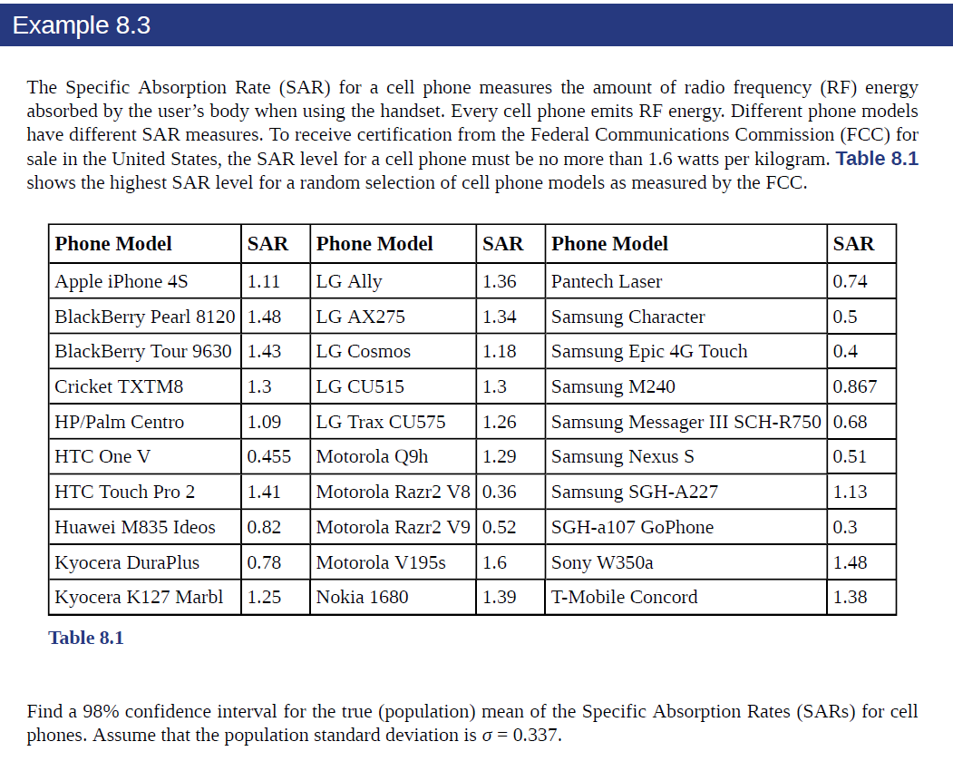

Slide 18
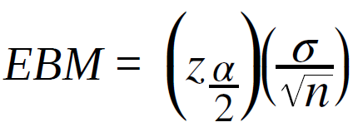
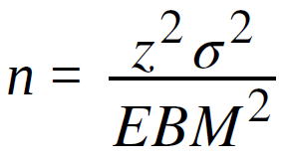
Calculating the Sample Size n
If researchers desire a specific margin of error, then they can use the error bound formula to calculate the required sample size.
The error bound formula for a population mean when the population standard deviation is known is
The formula for sample size is , found by solving the error bound formula for n.
In this formula, z is z_{α/2}, corresponding to the desired confidence level. A researcher planning a study who wants a specified confidence level and error bound can use this formula to calculate the size of the sample needed for the study.

Slide 19
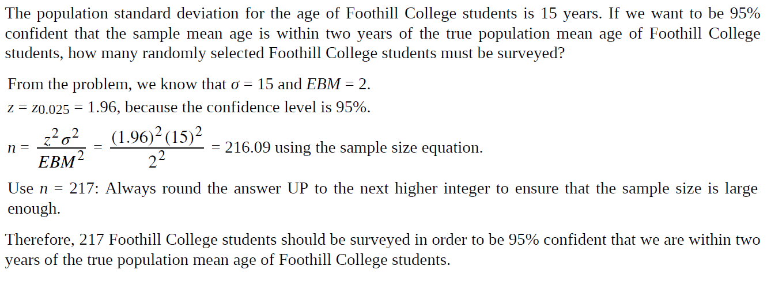
Example 8.7

Slide 20
8.2 A Single Population Mean using the Student t Distribution
In practice, we rarely know the population standard deviation. In the past, when the sample size was large, this did not present a problem to statisticians. They used the sample standard deviation s as an estimate for σ and proceeded as before to calculate a confidence interval with close enough results. However, statisticians ran into problems when the sample size was small. A small sample size caused inaccuracies in the confidence interval.
  William S. Goset (1876–1937) of the Guinness brewery in Dublin, Ireland ran into this problem. His experiments with hops and barley produced very few samples. Just replacing σ with s did not produce accurate results when he tried to calculate a confidence interval. He realized that he could not use a normal distribution for the calculation; he found that the actual distribution depends on the sample size. This problem led him to "discover" what is called the Student's t-distribution. The name comes from the fact that Gosset wrote under the pen name "Student.“

Slide 21
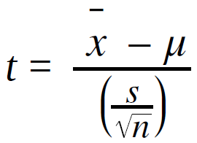
Student t Distribution
  Up until the mid-1970s, some statisticians used the normal distribution approximation for large sample sizes and only used the Student's t-distribution only for sample sizes of at most 30. With graphing calculators and computers, the practice now is to use the Student's t-distribution whenever s is used as an estimate for σ.
  If you draw a simple random sample of size n from a population that has an approximately a normal distribution with mean μ and unknown population standard deviation σ and calculate the t-score
  then the t-scores follow a Student's t-distribution with n – 1 degrees of freedom. The t-score has the same interpretation as the z-score. It measures how far x is from its mean μ. For each sample size n, there is a different Student's t-distribution.

Slide 22
Properties of the Student's t-Distribution
  The graph for the Student's t-distribution is similar to the standard normal curve.
  The mean for the Student's t-distribution is zero and the distribution is symmetric about zero.
  The Student's t-distribution has more probability in its tails than the standard normal distribution because the spread of the t-distribution is greater than the spread of the standard normal. So the graph of the Student's t-distribution will be thicker in the tails and shorter in the center than the graph of the standard normal distribution.
  The exact shape of the Student's t-distribution depends on the degrees of freedom. As the degrees of freedom increases, the graph of Student's t-distribution becomes more like the graph of the standard normal distribution.
  The underlying population of individual observations is assumed to be normally distributed with unknown population mean μ and unknown population standard deviation σ. The size of the underlying population is generally not relevant unless it is very small. If it is bell shaped (normal) then the assumption is met and doesn't need discussion. Random sampling is assumed, but that is a completely separate assumption from normality.

Slide 23
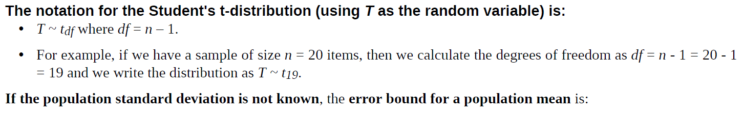
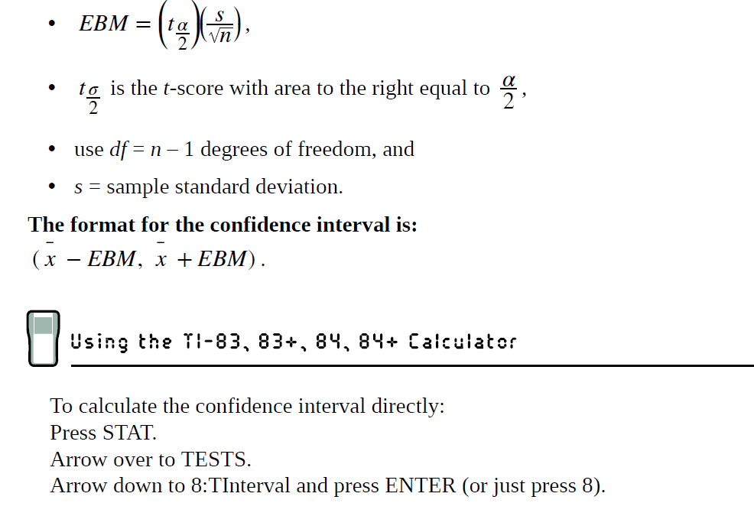

Slide 24
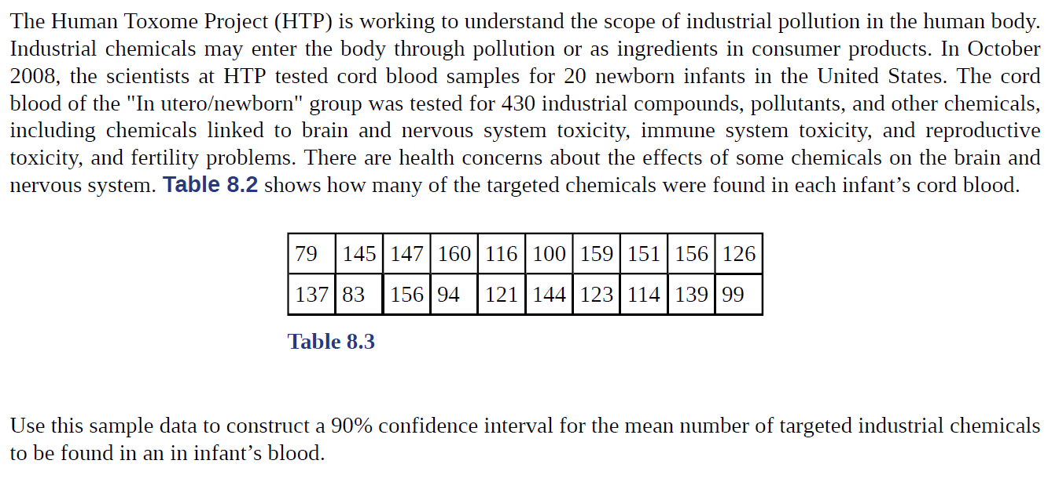
Example 8.9

Slide 25
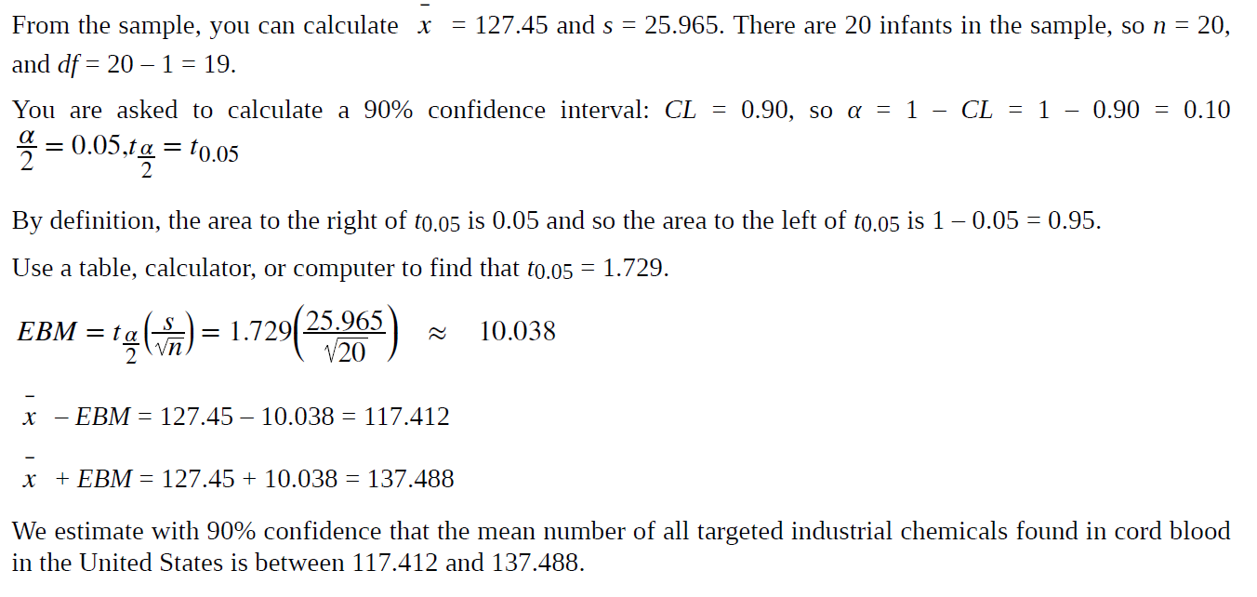
Example 8.9
Solution (Step-by-Step)

Slide 26
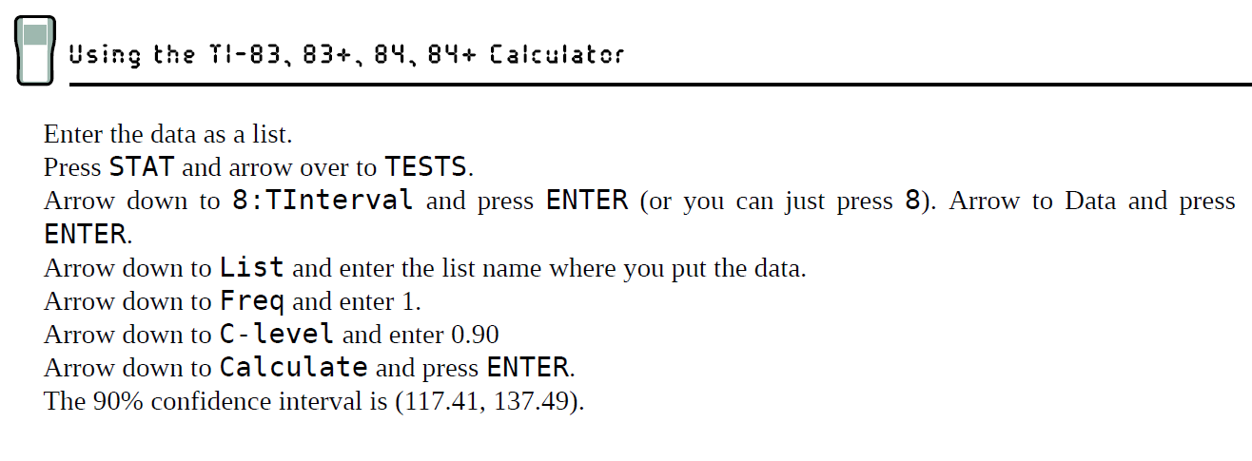
Example 8.9
Solution (Calculator)

Slide 27
8.3 | A Population Proportion
Example
  During an election year, we see articles in the newspaper that state confidence intervals in terms of proportions or percentages. For example, a poll for a particular candidate running for president might show that the candidate has 40% of the vote within three percentage points (if the sample is large enough). Often, election polls are calculated with 95% confidence, so, the pollsters would be 95% confident that the true proportion of voters who favored the candidate would be between 0.37 and 0.43: (0.40 – 0.03,0.40 + 0.03).
The procedure to find the confidence interval, the sample size, the error bound, and the confidence level for a proportion is similar to that for the population mean, but the formulas are different.

Slide 28


Population Proportion Problem
How do you know you are dealing with a proportion problem? First, the underlying distribution is a binomial distribution. (There is no mention of a mean or average.) If X is a binomial random variable, then X ~ B(n, p) where n is the number of trials and p is the probability of a success. To form a proportion, take X, the random variable for the number of successes and divide it by n, the number of trials (or the sample size). The random variable P′ (read "P prime") is that proportion,
(Sometimes the random variable is denoted as , read "P hat".)

Slide 29


From Binomial to normal
When n is large and p is not close to zero or one, we can use the normal distribution to approximate the binomial.
If we divide the random variable, the mean, and the standard deviation by n, we get a normal distribution of proportions with P′, called the estimated proportion, as the random variable. (Recall that a proportion as the number of successes divided by n.)

Slide 30


From Binomial to normal
(Continued)
Using algebra to simplify :
P′ follows a normal distribution for proportions:

Slide 31
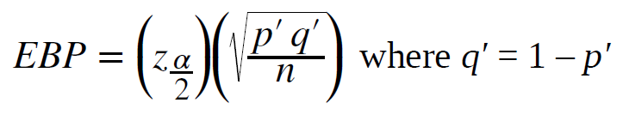
Confidence Interval for Proportions
The confidence interval has the form (p′ – EBP, p′ + EBP). EBP is error bound for the proportion.
p′ = x/n
p′ = the estimated proportion of successes (p′ is a point estimate for p, the true proportion.)
x = the number of successes
n = the size of the sample
The error bound for a proportion is

Slide 32
Confidence Interval for Proportions
The confidence interval has the form (p′ – EBP, p′ + EBP). EBP is error bound for the proportion.
p′ = x/n
p′ = the estimated proportion of successes (p′ is a point estimate for p, the true proportion.)
x = the number of successes
n = the size of the sample
The error bound for a proportion is

Slide 33



Error Bound formula and Standard Deviation
  This formula is similar to the error bound formula for a mean, except that the "appropriate standard deviation" is different. For a mean, when the population standard deviation is known, the appropriate standard deviation that we use is
  For a proportion, the appropriate standard deviation is
  However, in the error bound formula, we use as the standard deviation, instead of .
  In the error bound formula, the sample proportions p′ and q′ are estimates of the unknown population proportions p and q. The estimated proportions p′ and q′ are used because p and q are not known. The sample proportions p′ and q′ are calculated from the data: p′ is the estimated proportion of successes, and q′ is the estimated proportion of failures.

Slide 34
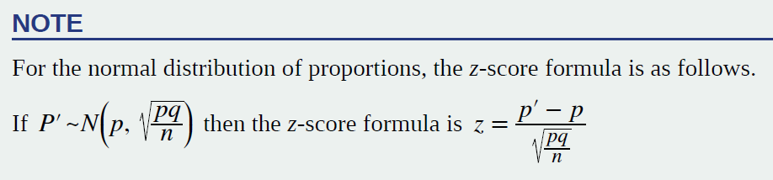
Success and Failure condition
The confidence interval can be used only if the number of successes np′ and the number of failures nq′ are both greater than five.

Slide 35
Example 8.11
For a class project, a political science student at a large university wants to estimate the percent of students who are registered voters. He surveys 500 students and finds that 300 are registered voters. Compute a 90% confidence interval for the true percent of students who are registered voters, and interpret the confidence interval.
Solution 8.11
• The first solution is step-by-step (Solution A).
• The second solution uses a function of the TI-83, 83+, or 84 calculators (Solution B).

Slide 36
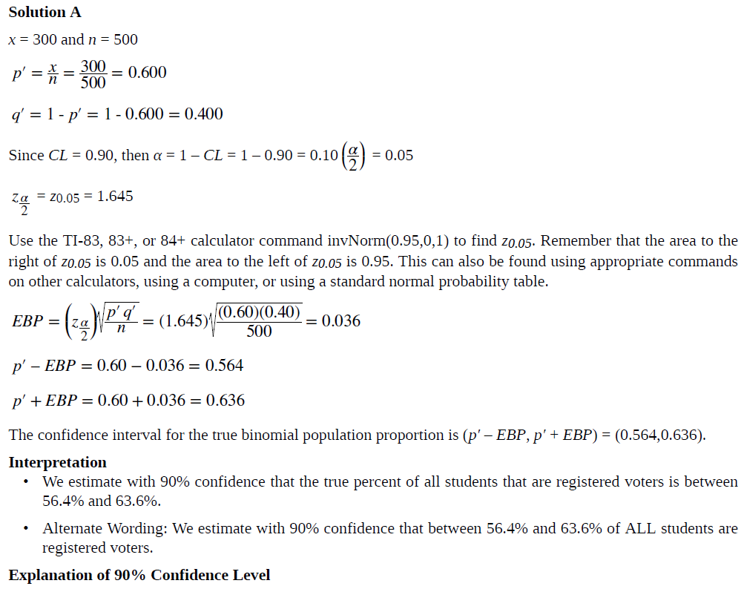

Slide 37
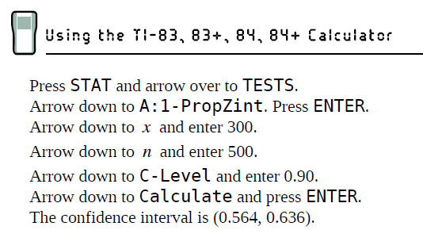
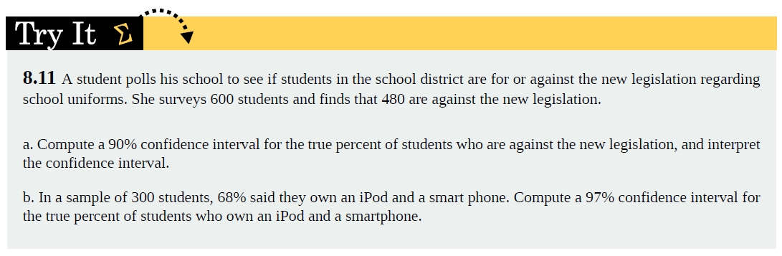
Example 8.1
Solution B

Slide 38
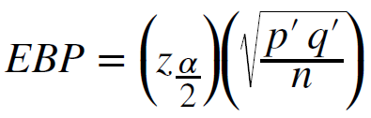
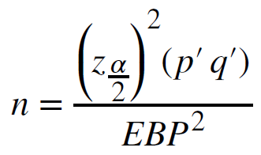
Calculating the Sample Size n
If researchers desire a specific margin of error, then they can use the error bound formula to calculate the required sample size.
  The error bound formula for a population proportion is
  Solving for n gives you an equation for the sample size.

Slide 39
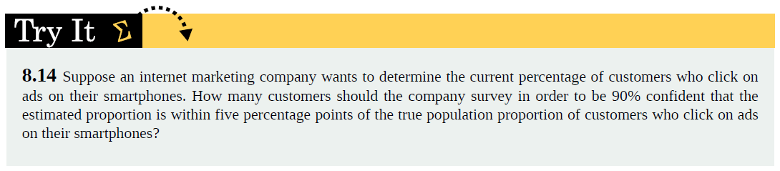
Example 8.14
Suppose a mobile phone company wants to determine the current percentage of customers aged 50+ who use text messaging on their cell phones. How many customers aged 50+ should the company survey in order to be 90% confident that the estimated (sample) proportion is within three percentage points of the true population proportion of customers aged 50+ who use text messaging on their cell phones.

